Slide 1
Machine learning
Naïve bayes

Slide 2
Naïve bayes
A family of simple "probabilistic classifiers" based on applying Bayes' theorem with strong (naive) independence assumptions between the features.
It's called "naive" because it assumes that all the features are independent of each other, which is a simplification of real-world situations.

Slide 3
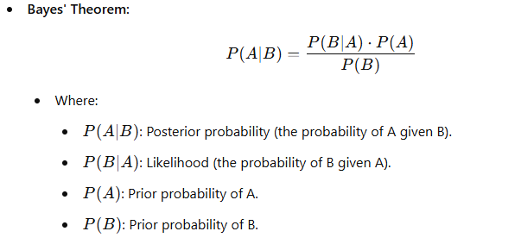
Bayes’Thearom

Slide 4
Bayes’Thearom

Slide 5
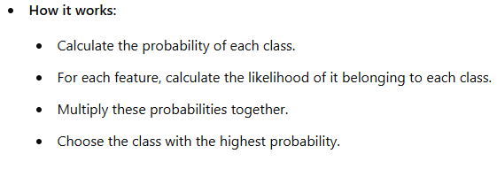
Naive Bayes Classifier

Slide 6
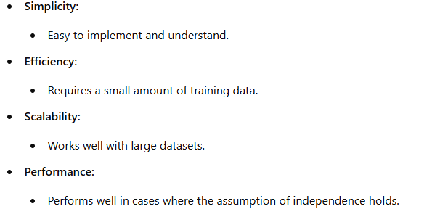
Advantages

Slide 7
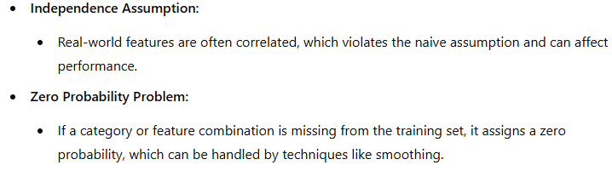
Disadvantages

Slide 8
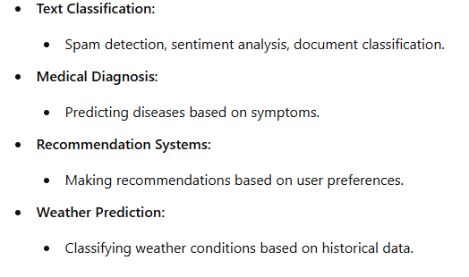
Applications

Slide 9
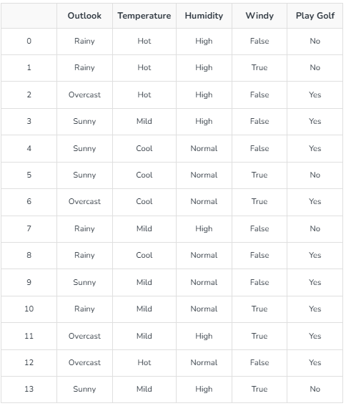
Which Class??
today = (Sunny, Hot, Normal, False)

